Slide 1
Chapter 6
Application Layer
Copyright © The McGraw-Hill Companies, Inc. Permission required for reproduction or display.

Slide 2
Outline
Overview of Transport Layer
HTPP and Web
Domain name
Electrical Email
File transfer

Slide 3
2. HTTP
The Hypertext Transfer Protocol (HTTP) is a protocol used mainly to access data on the World Wide Web. HTTP functions as a combination of FTP and SMTP.
Topics discussed in this section:
HTTP Transaction
Persistent Versus Nonpersistent Connection

Slide 4

Note
HTTP uses the services of TCP on well-known port 80.

Slide 5
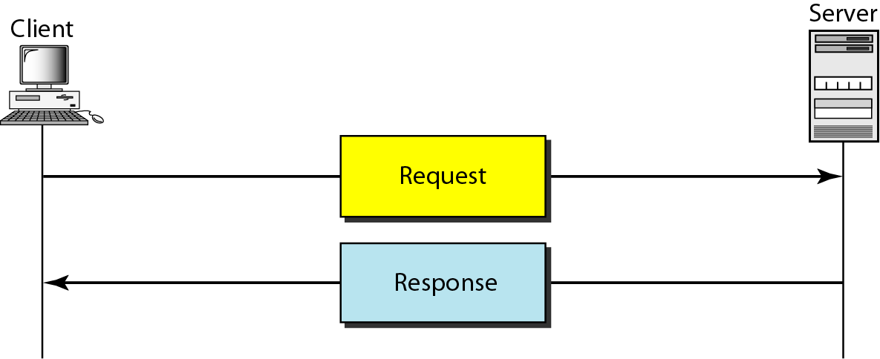
HTTP transaction

Slide 6
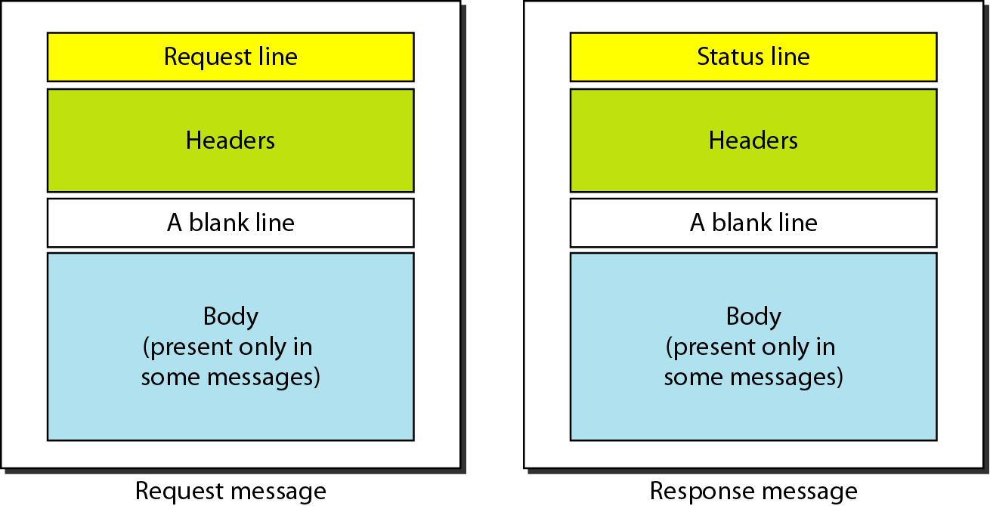
Request and response messages

Slide 7
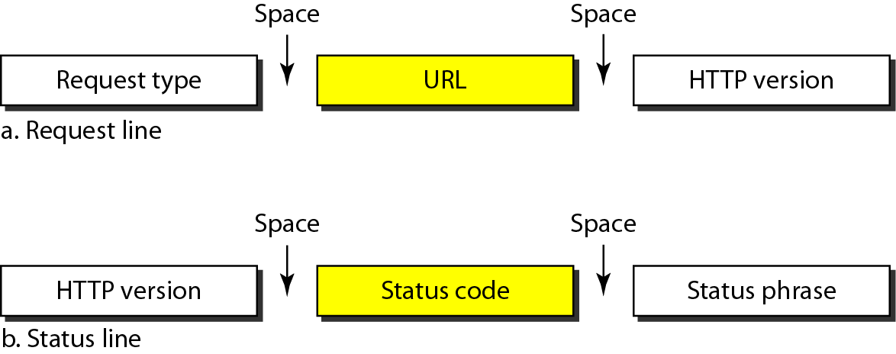
Request and status lines

Slide 8
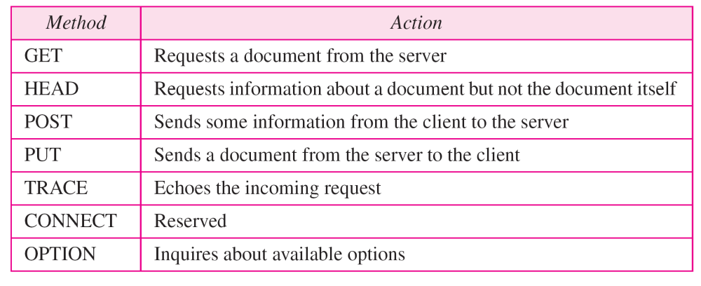
Methods

Slide 9
Status codes

Slide 10
Status codes (continued)

Slide 11
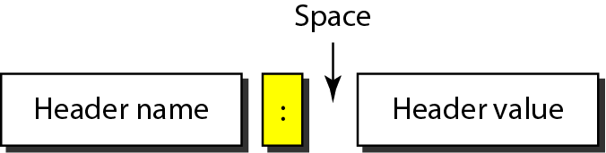
Header format

Slide 12
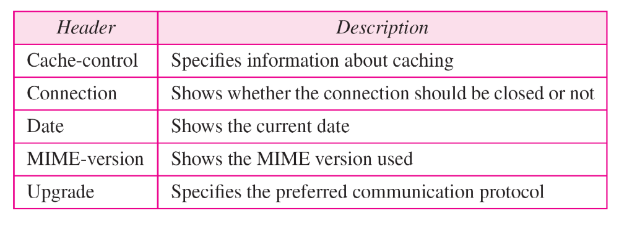
General headers

Slide 13
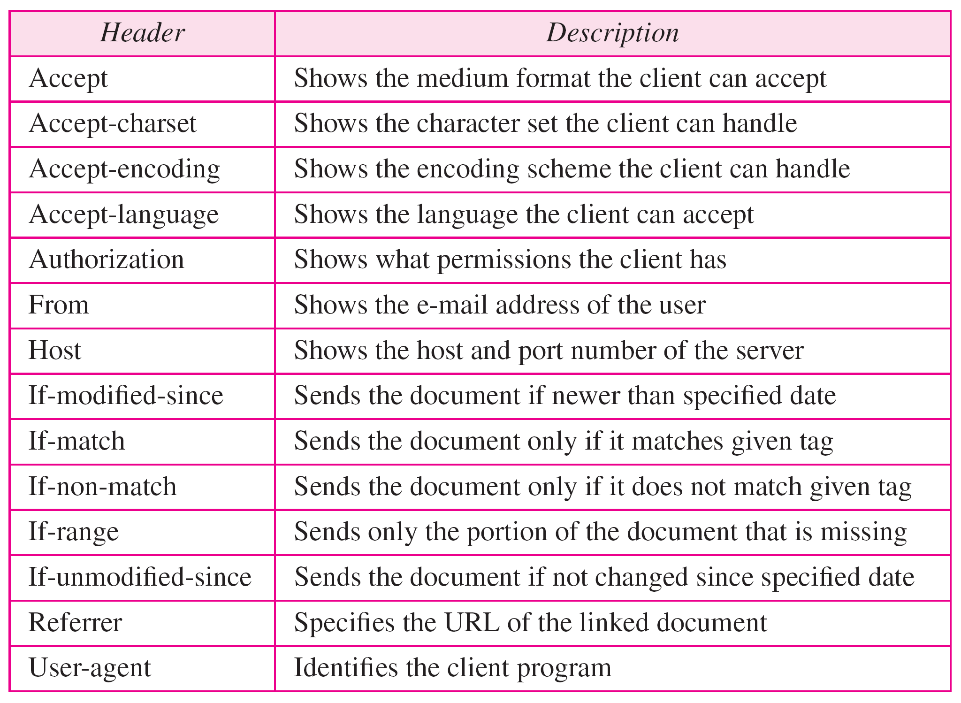
Request headers

Slide 14
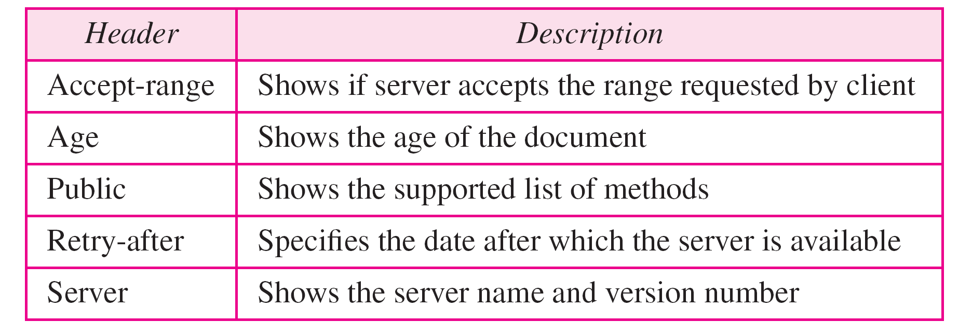
Response headers

Slide 15
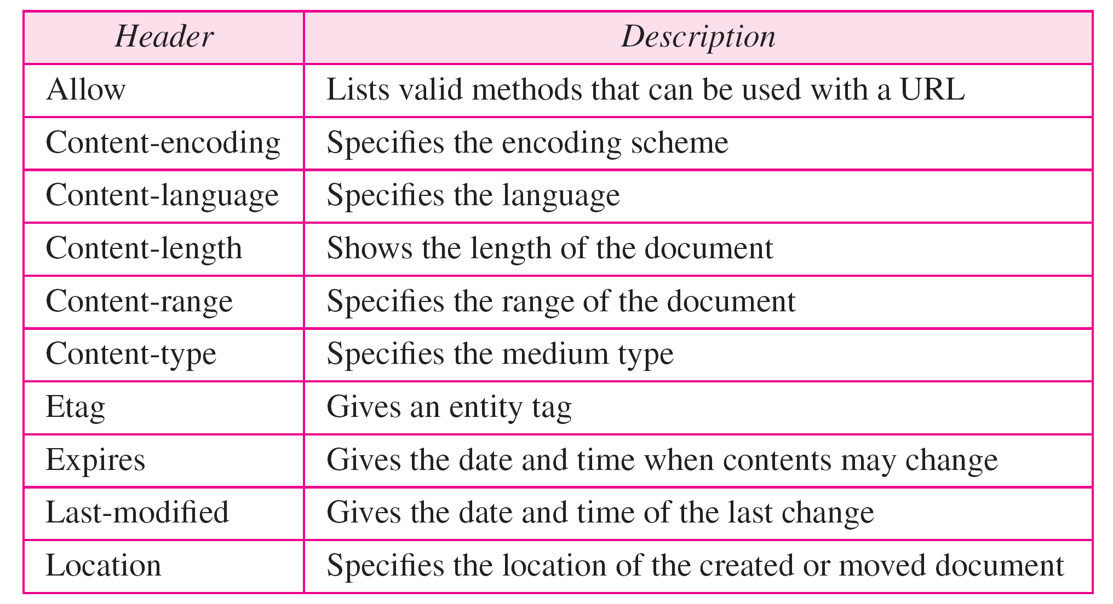
Entity headers

Slide 16
Example
This example retrieves a document. We use the GET method to retrieve an image with the path /usr/bin/image1. The request line shows the method (GET), the URL, and the HTTP version (1.1). The header has two lines that show that the client can accept images in the GIF or JPEG format. The request does not have a body. The response message contains the status line and four lines of header. The header lines define the date, server, MIME version, and length of the document. The body of the document follows the header (see Figure 27.16).

Slide 17
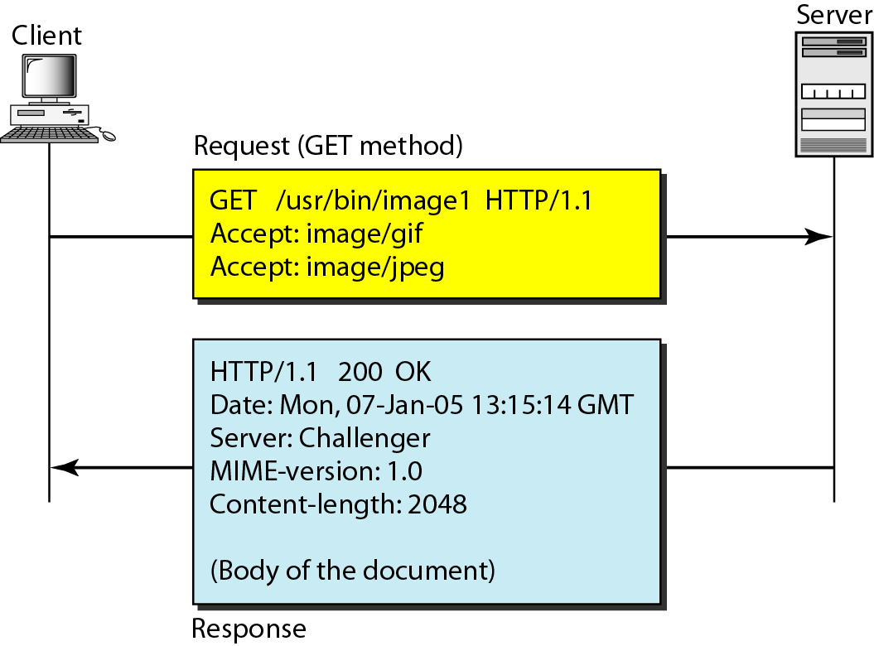
Figure

Slide 18
Example
In this example, the client wants to send data to the server. We use the POST method. The request line shows the method (POST), URL, and HTTP version (1.1). There are four lines of headers. The request body contains the input information. The response message contains the status line and four lines of headers. The created document, which is a CGI document, is included as the body (see Figure 27.17).

Slide 19
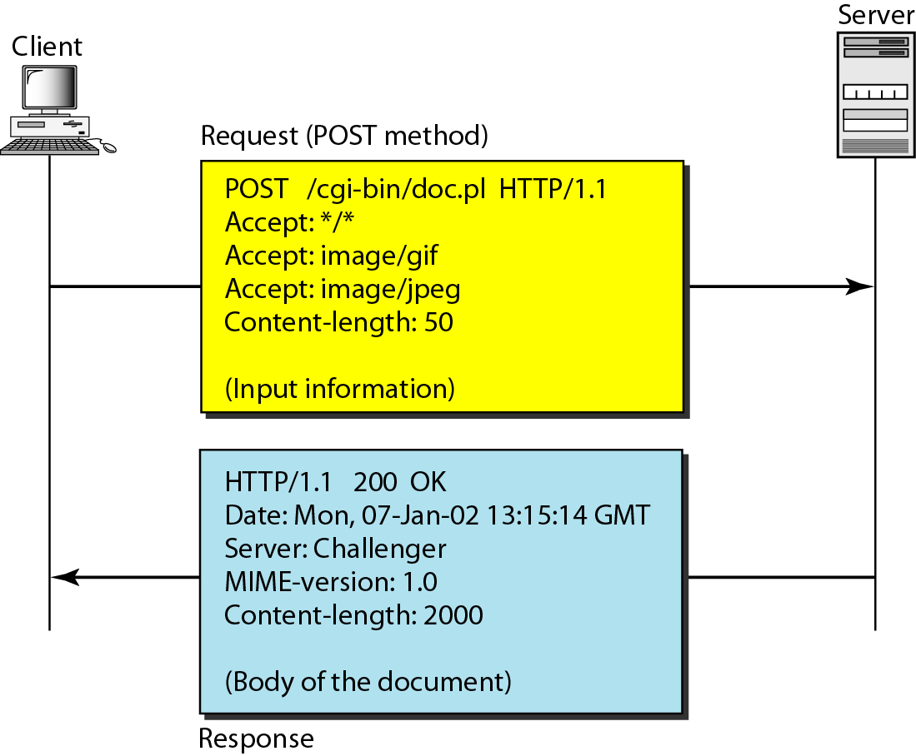
Figure

Slide 20
Example
HTTP uses ASCII characters. A client can directly connect to a server using TELNET, which logs into port 80 (see next slide). The next three lines show that the connection is successful. We then type three lines. The first shows the request line (GET method), the second is the header (defining the host), the third is a blank, terminating the request. The server response is seven lines starting with the status line. The blank line at the end terminates the server response. The file of 14,230 lines is received after the blank line (not shown here). The last line is the output by the client.

Slide 21
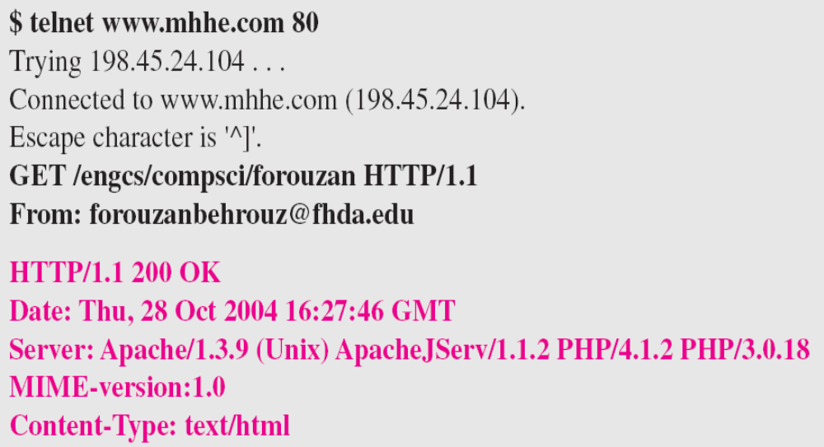
Example (continued)

Slide 22
Note
HTTP version 1.1 specifies a persistent connection by default.

Slide 23
3. DOMAIN NAME SYSTEM
To have a hierarchical name space, a domain name space was designed. In this design the names are defined in an inverted-tree structure with the root at the top. The tree can have only 128 levels: level 0 (root) to level 127.
Topics discussed in this section:
Label
Domain Name
Domain

Slide 24

Domain name space

Slide 25

Domain names and labels

Slide 26

Domains

Slide 27
NAME RESOLUTION
Mapping a name to an address or an address to a name is called name-address resolution.

Slide 28

Recursive resolution

Slide 29

Iterative resolution

Slide 30
DNS MESSAGES
DNS has two types of messages: query and response. Both types have the same format. The query message consists of a header and question records; the response message consists of a header, question records, answer records, authoritative records, and additional records.
Topics discussed in this section:
Header

Slide 31
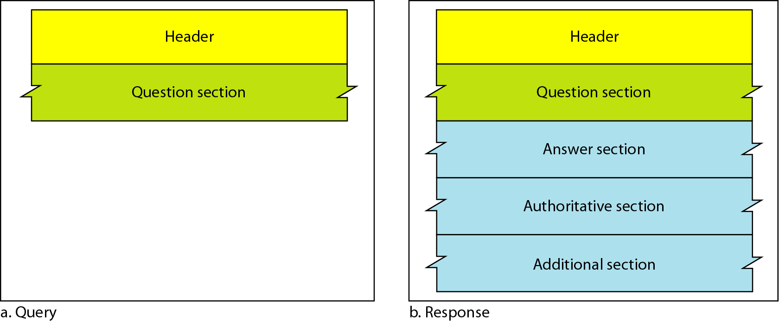
Query and response messages

Slide 32
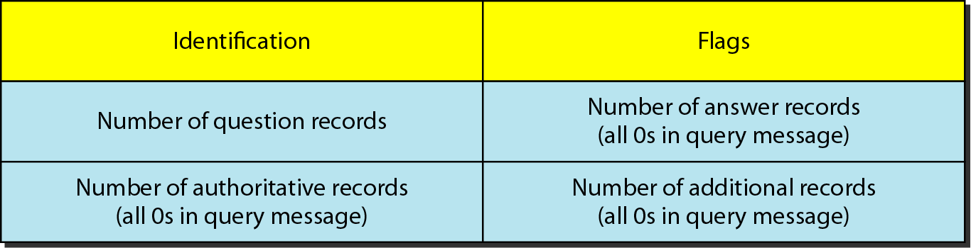
Header format

Slide 33
4 ELECTRONIC MAIL
One of the most popular Internet services is electronic mail (e-mail). The designers of the Internet probably never imagined the popularity of this application program. Its architecture consists of several components that we discuss in this chapter.
Topics discussed in this section:
Architecture
User Agent
Message Transfer Agent: SMTP
Message Access Agent: POP and IMAP
Web-Based Mail

Slide 34

First scenario in electronic mail

Slide 35
Note
When the sender and the receiver of an e-mail are on the same system,
we need only two user agents.

Slide 36

Second scenario in electronic mail

Slide 37
Note
When the sender and the receiver of an e-mail are on different systems, we
need two UAs and a pair of
MTAs (client and server).

Slide 38

Third scenario in electronic mail

Slide 39
Note
When the sender is connected to the mail server via a LAN or a WAN,
we need two UAs and two pairs
of MTAs (client and server).

Slide 40

Fourth scenario in electronic mail

Slide 41

Push versus pull in electronic email

Slide 42
Note
When both sender and receiver are connected to the mail server via
a LAN or a WAN, we need two
UAs, two pairs of MTAs
and a pair of MAAs.
This is the most common situation today.

Slide 43

Services of user agent

Slide 44
Note
Some examples of command-driven user agents are mail, pine,
and elm.

Slide 45
Note
Some examples of GUI-based user agents are Eudora, Outlook, and Netscape.

Slide 46

Format of an e-mail

Slide 47

E-mail address

Slide 48
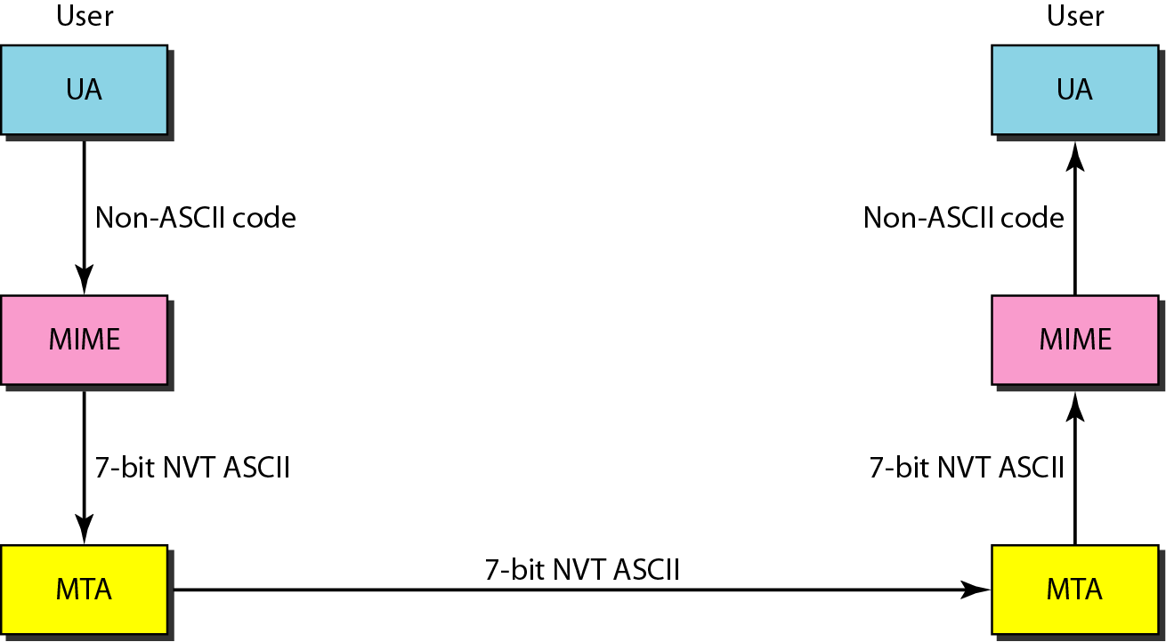
MIME

Slide 49
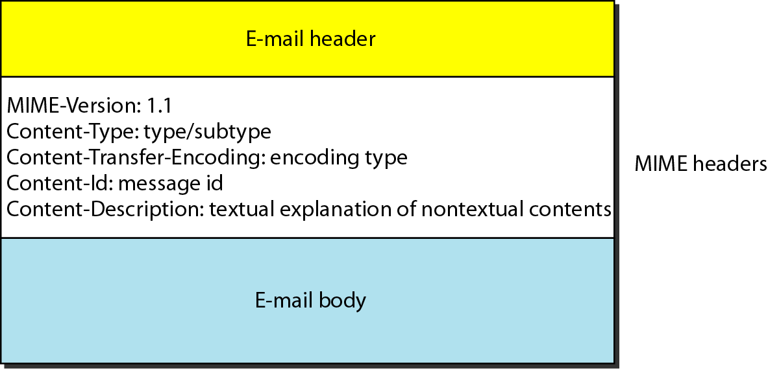
MIME header

Slide 50
Data types and subtypes in MIME

Slide 51
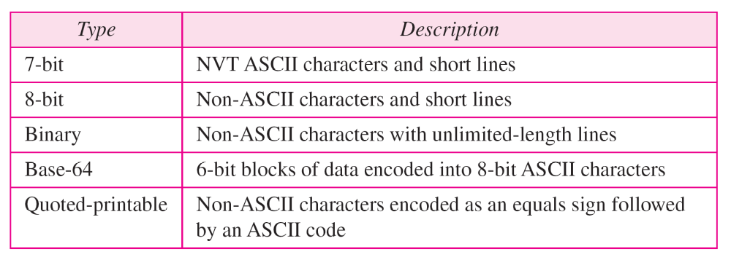
Content-transfer-encoding

Slide 52
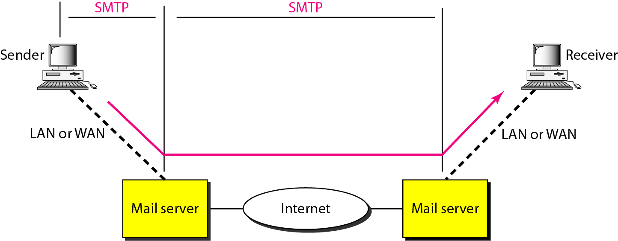
SMTP range

Slide 53

Commands and responses

Slide 54

Command format

Slide 55
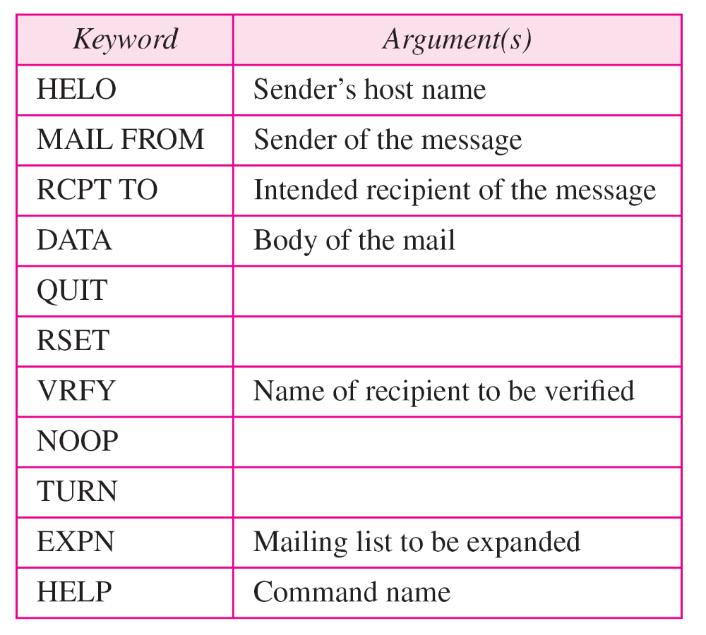
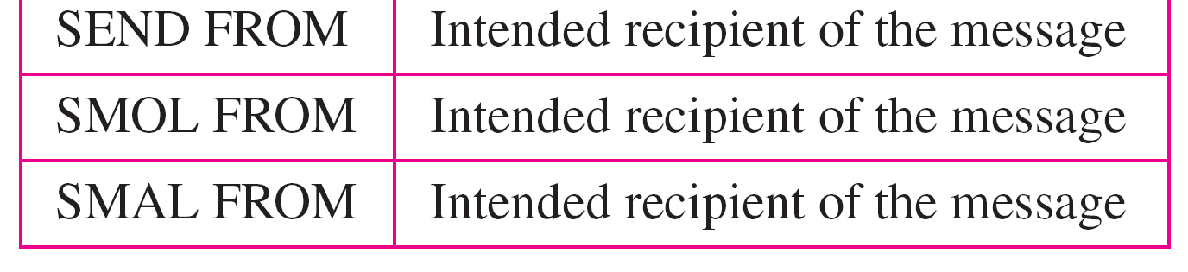
Commands

Slide 56
Responses

Slide 57
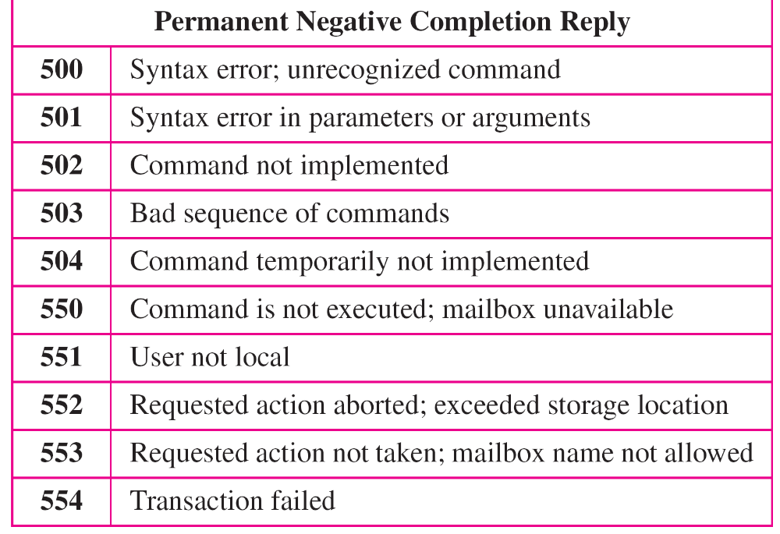
Responses (continued)

Slide 58
Example
Let us see how we can directly use SMTP to send an
e-mail and simulate the commands and responses we described in this section. We use TELNET to log into port 25 (the well-known port for SMTP). We then use the commands directly to send an e-mail. In this example, forouzanb@adelphia.net is sending an e-mail to himself. The first few lines show TELNET trying to connect to the Adelphia mail server. After connection, we can type the SMTP commands and then receive the responses, as shown on the next slide. Note that we have added, for clarification, some comment lines, designated by the “=” signs. These lines are not part of the e-mail procedure.

Slide 59
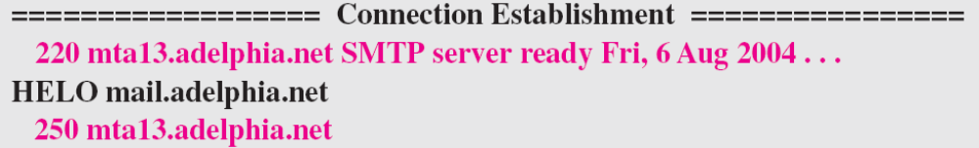
Example (continued)
$ telnet mail.adelphia.net 25
Trying 68.168.78.100 . . .
Connected to mail.adelphia.net (68.168.78.100).

Slide 60
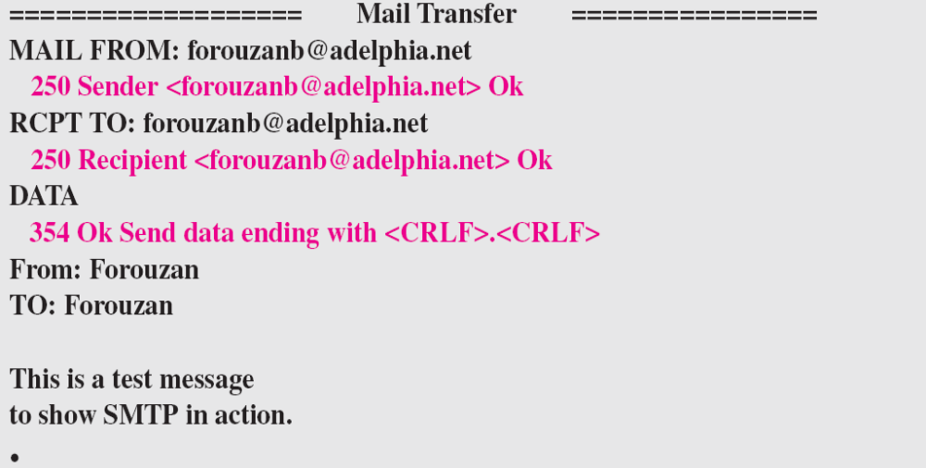
Example (continued)

Slide 61
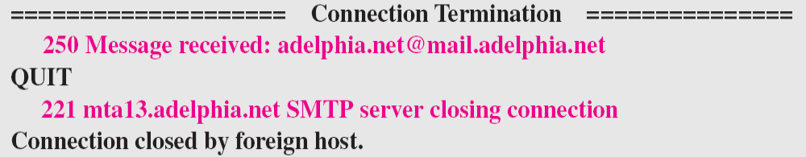
Example (continued)

Slide 62
Example (continued)

Slide 63
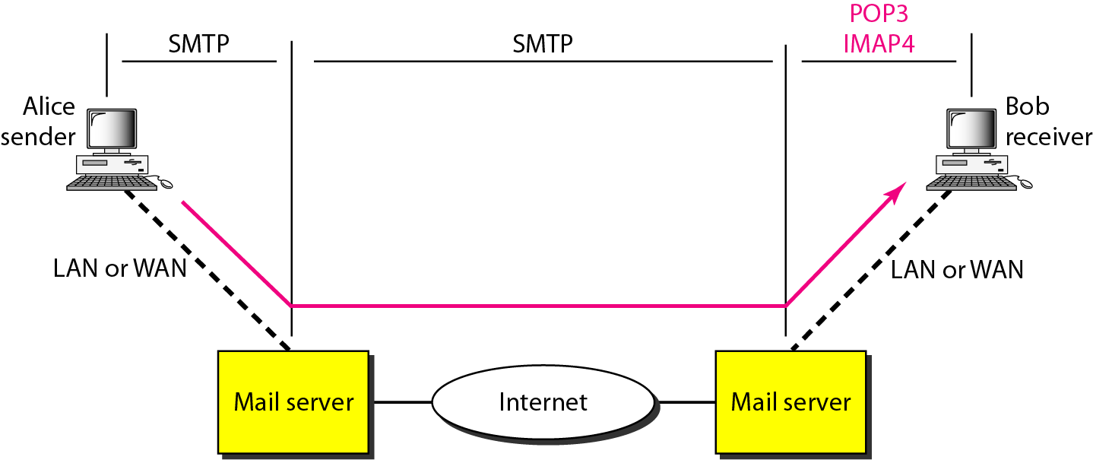
POP3 and IMAP4

Slide 64
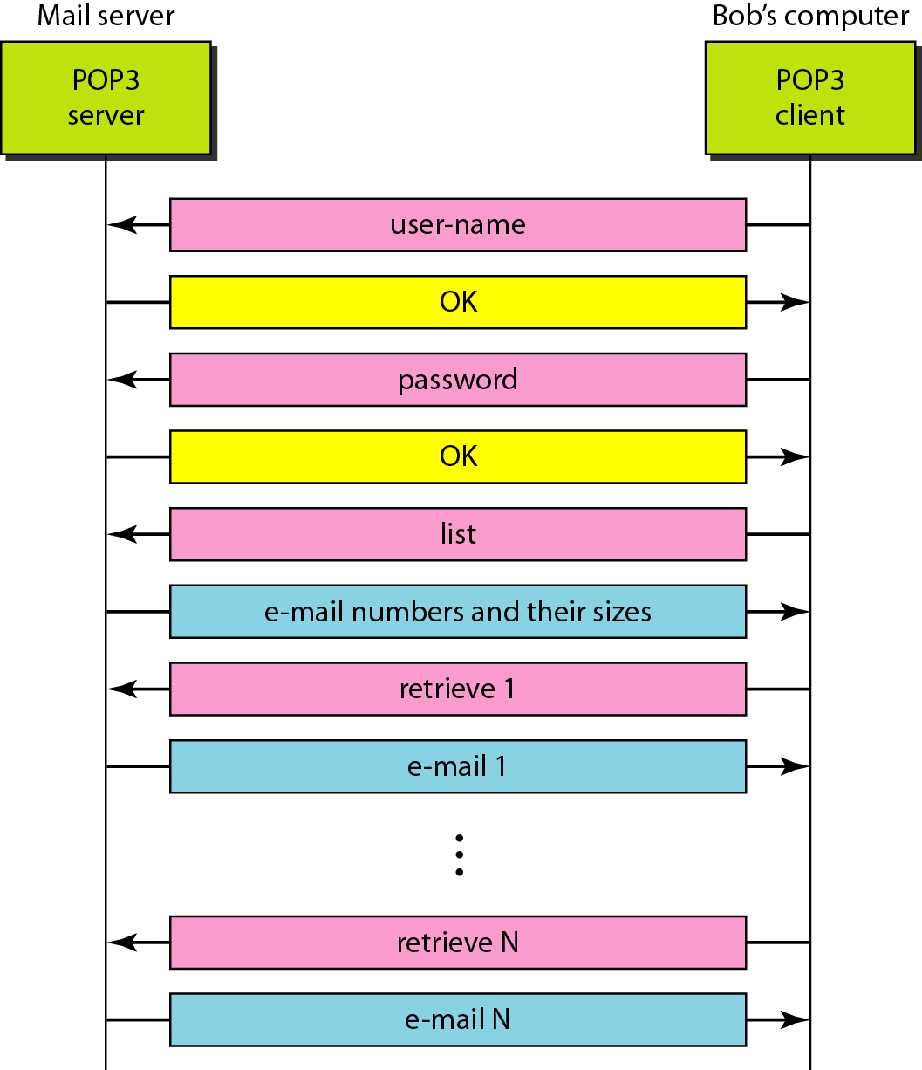
The exchange of commands and responses in POP3

Slide 65
5 FILE TRANSFER
Transferring files from one computer to another is one of the most common tasks expected from a networking or internetworking environment. As a matter of fact, the greatest volume of data exchange in the Internet today is due to file transfer.
Topics discussed in this section:
File Transfer Protocol (FTP)
Anonymous FTP

Slide 66
Note
FTP uses the services of TCP. It needs two TCP connections.
The well-known port 21 is used for the control connection and the well-known port 20 for the data connection.

Slide 67
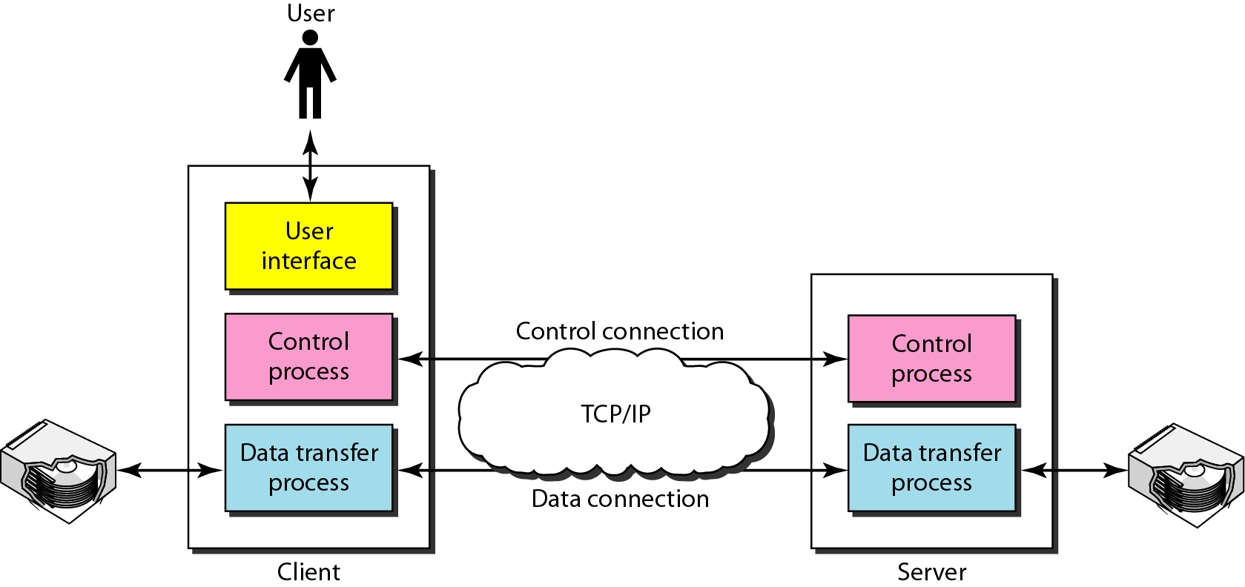
FTP

Slide 68
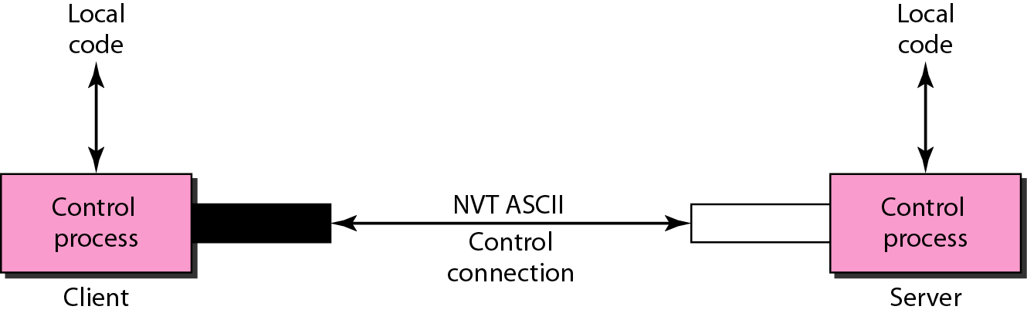
Using the control connection

Slide 69
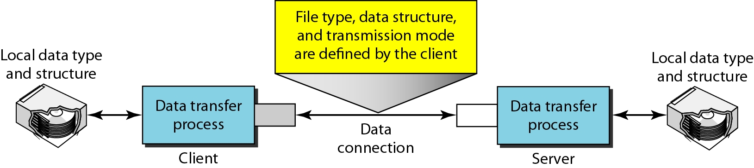
Using the data connection

Slide 70
Example
The following shows an actual FTP session for retrieving a list of items in a directory. The colored lines show the responses from the server control connection; the black lines show the commands sent by the client. The lines in white with a black background show data transfer.
1. After the control connection is created, the FTP server
sends the 220 response.
2. The client sends its name.
3. The server responds with 331.

Slide 71
Example (continued)
4. The client sends the password (not shown).
5. The server responds with 230 (user log-in is OK).
6. The client sends the list command (ls reports) to find
the list of files on the directory named report.
7. Now the server responds with 150 and opens the data
connection.
8. The server then sends the list of the files or directories
on the data connection.
9. The client sends a QUIT command.
10. The server responds with 221.

Slide 72
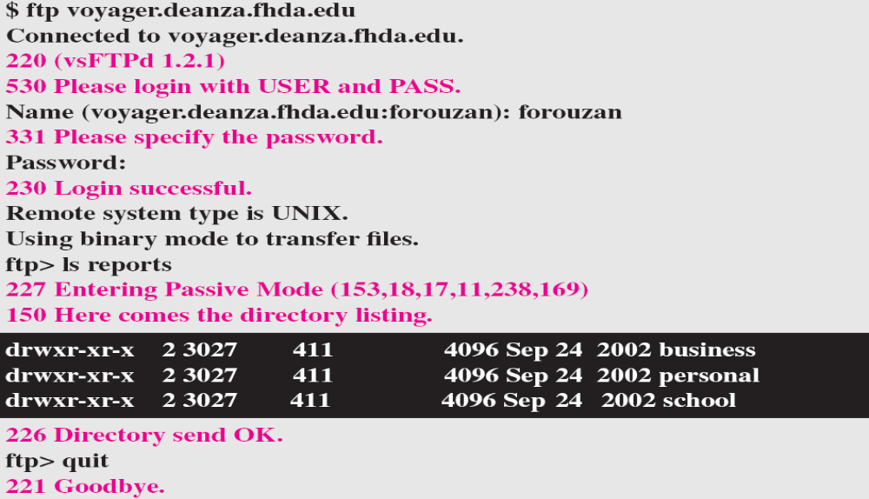
Example (continued)

Slide 73
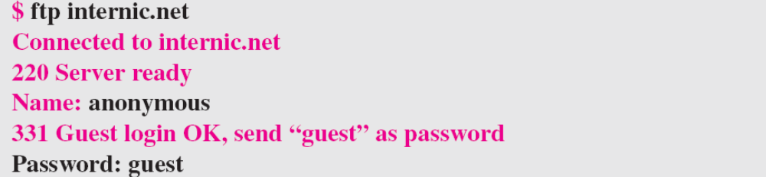
Example
We show an example of anonymous FTP. We assume that some public data are available at internic.net.
We show an example of anonymous FTP. We assume that some public data are available at internic.net.
continued on next slide

Slide 74
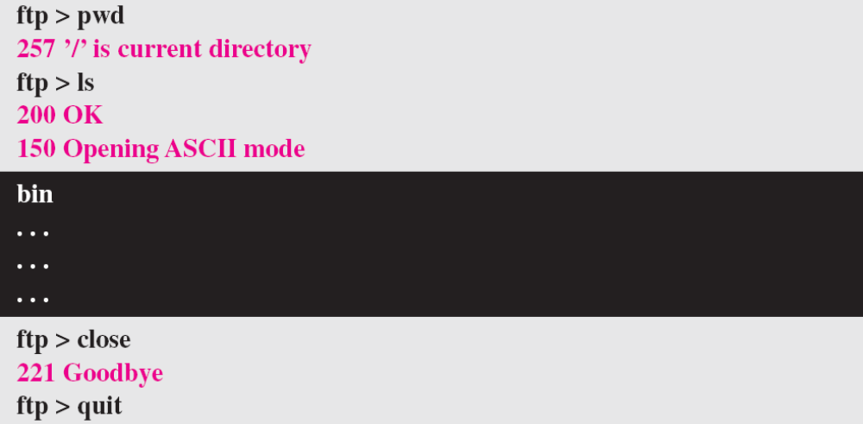
Example (continued)

